Slide 1


Introduction to
Robotic Process Automation
Automated Product Data Entry for Ecommerce Bookstore Using Robotic Process Automation (RPA)
220701070
DIVYASHREE S
Mrs. J. Jinu Sophia
Assistant Professor (SG)

Slide 2
Abstract
This project utilizes Robotic Process Automation (RPA) to automate product data entry for an eCommerce bookstore, replacing manual tasks with an efficient, error-free solution. The RPA bot extracts book details, such as title, price, stock, and description, from an Excel sheet and inputs them into the Admin Panel for product data entry. Features include automated data formatting, error detection for missing or incorrect entries, and email notifications for new arrivals. This system improves time efficiency, reduces errors, enhances user engagement, and supports scalability, enabling administrators to focus on strategic activities while managing a growing product catalog seamlessly.

Slide 3
Need for the Proposed System
Time Efficiency:Manually entering product details into the web application is time-consuming, especially when handling large volumes of data. Automating this process significantly reduces the time required.
Error Reduction: Eliminates mistakes like typos or missing information during data entry.
Scalability: Handles a growing number of products efficiently as the platform expands.
Improved Productivity: Frees up administrators to focus on strategic and high-priority tasks.
Enhanced User Engagement: Sends automatic emails to inform users about new product arrivals.
Cost-Effectiveness: Reduces manual work, lowering overall operational costs.

Slide 4
Advantages of the Proposed System
Increased Efficiency: Speeds up product data entry.
Higher Accuracy: Reduces human errors in data entry.
Time and Cost Savings: Cuts down on manual work, saving time and money.
Enhanced User Experience: Keeps users informed with automatic updates.
Scalable: Easily handles growing product catalogs.
Improved Decision-Making: Frees up admins to focus on more important tasks.
Streamlined Operations: Ensures a smooth and efficient workflow.

Slide 5
Literature Survey
Paper 1:
Title: Automation of Data Entry Tasks Using RPA Advantages:
Reduces manual effort and errors.
Scalable for large data volumes. Disadvantages:
Time-intensive setup.
Limited for unstructured data.
Paper 2:
Title: Error Management in Automated Data Entry Systems Advantages:
Robust error detection and logging.
Ensures consistent data formatting. Disadvantages:
Adds workflow complexity.
Higher resource utilization.

Slide 6
Main Objective
The main objective of this project is to automate the process of adding product details from an Excel file into an eCommerce bookstore web application using Robotic Process Automation (RPA). This system aims to eliminate manual data entry, reduce errors, improve efficiency, and ensure accurate and timely product updates. Additionally, it automatically sends email notifications to users about new product arrivals, enhancing user engagement and overall system productivity.

Slide 7
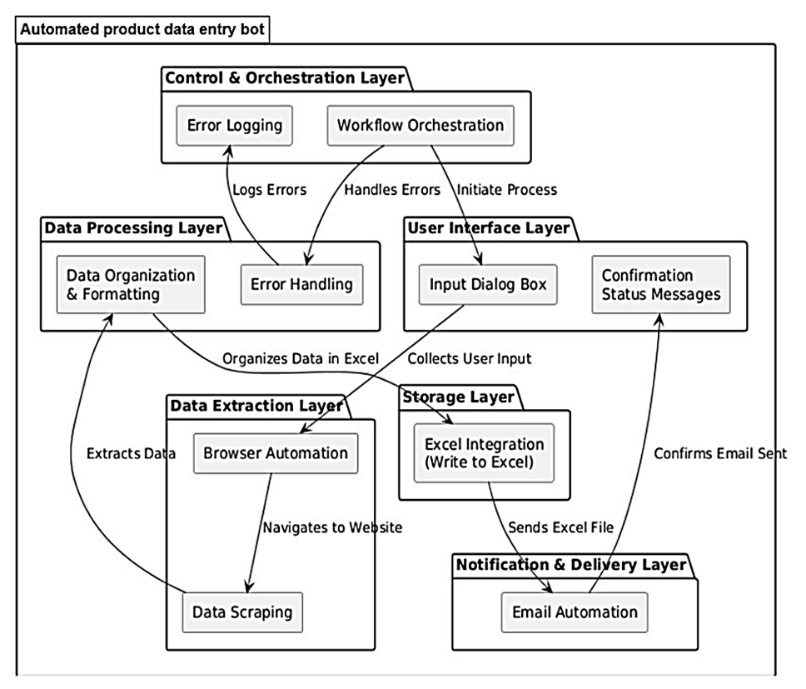
Architecture

Slide 8
System Requirements
Hardware Requirements
Processor: Intel Core i3 or higher
RAM: 4 GB or more
Hard Disk: 500 GB or more
Display: Minimum 1366x768 resolution
Internet Connection: Required for email notifications and web access
Software Requirements
Operating System: Windows 11 or later / Linux / macOS
Web Browser: Google Chrome / Mozilla Firefox / Microsoft Edge
RPA Tool: UiPath / Automation Anywhere / Blue Prism (or any other RPA tool)
Database: MySQL / PostgreSQL (for storing product data)
Microsoft Excel: For inputting and managing product details
Email Server: SMTP server for sending automatic email notifications
Programming Languages: javascript, php
IDE: Visual Studio / PyCharm / UiPath Studio

Slide 9
Functional Description
Name of the Module 1: Product Data Extraction and Automated Data Entry This module is responsible for extracting product details such as book title, price, stock, and description from a structured Excel sheet. The system validates the data for completeness and formats it to ensure consistency and input the product details before passing it to the next module
Module 2: Email Notification for New Arrivals This module automatically sends email notifications to registered users to inform them about newly added books in the eCommerce bookstore. The notification includes details such as the book title, price, and a link to view or purchase the book. This ensures enhanced user engagement and keeps customers updated about the latest products.

Slide 10
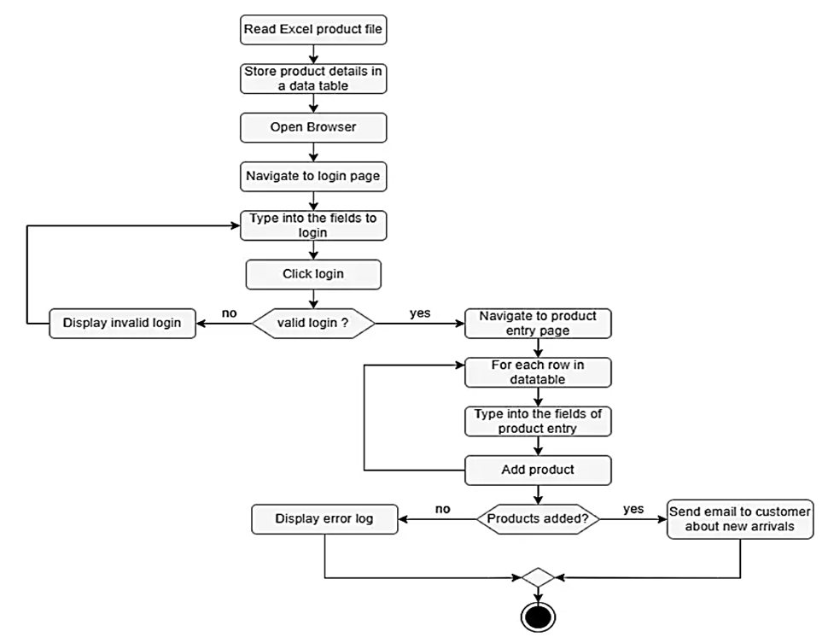
Functional Description

Slide 11
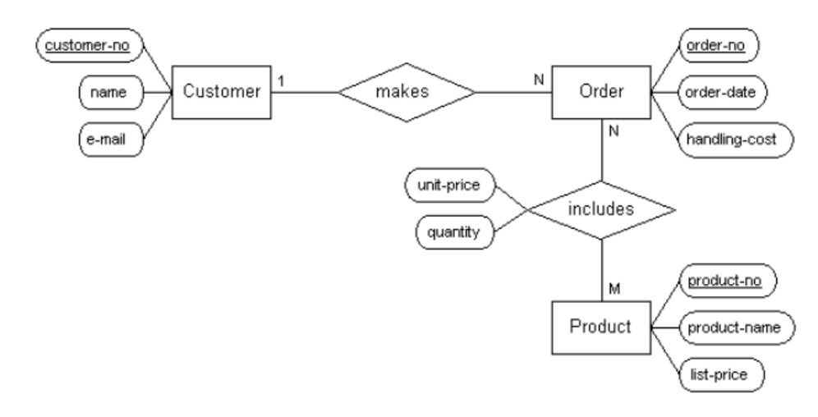
Table Design
ER Diagram

Slide 12
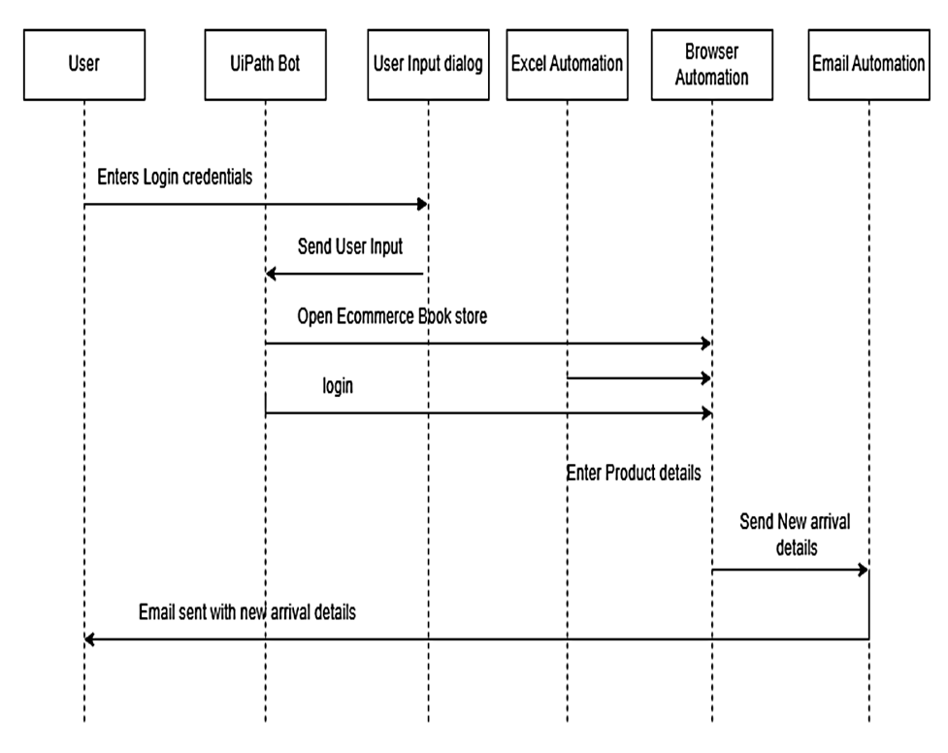
Sequence Diagram

Slide 13
Process Design
Main Process: Automated Product Data Entry and Notification
This process encompasses the end-to-end automation of product data entry and email notifications in an eCommerce bookstore using Robotic Process Automation (RPA). The main process ensures that product details are accurately entered into the system and users are notified about new arrivals.
Sub Processes:
Data Extraction:
Read product details from an Excel file.
Validate and format data for accuracy.
Product Entry Automation:
Use RPA to log into the Admin Panel and input product details.
Handle errors during the process.
Email Notification:
Generate personalized emails for users about new arrivals.
Send emails using an SMTP server and log delivery status.

Slide 14
Implementation
Name of the Module 1: Product Data Extraction
Short Description: This module is responsible for extracting product details such as book title, price, stock, and description from a structured Excel sheet. The system validates the data for completeness and formats it to ensure consistency and input the extracted product details in the web application

Slide 15
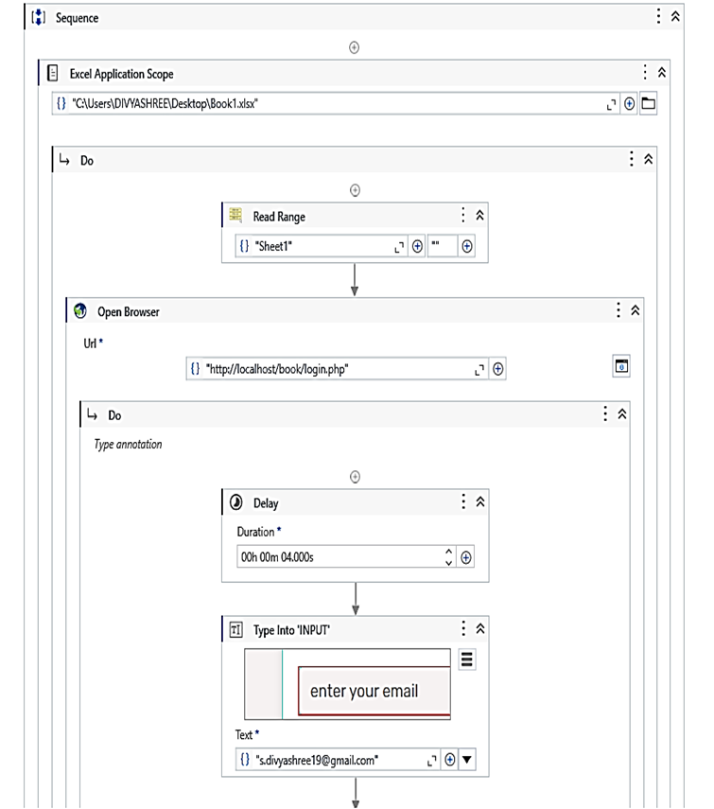
Implementation

Slide 16
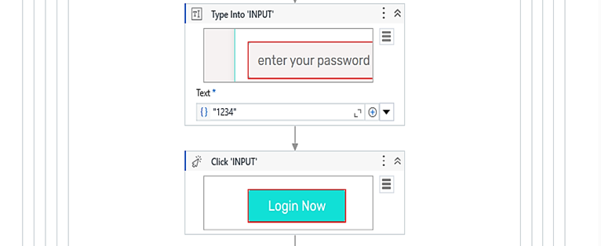
Implementation

Slide 17
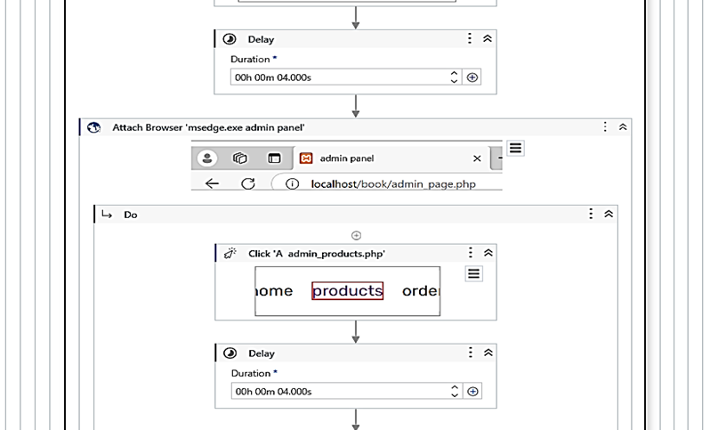
Implementation

Slide 18
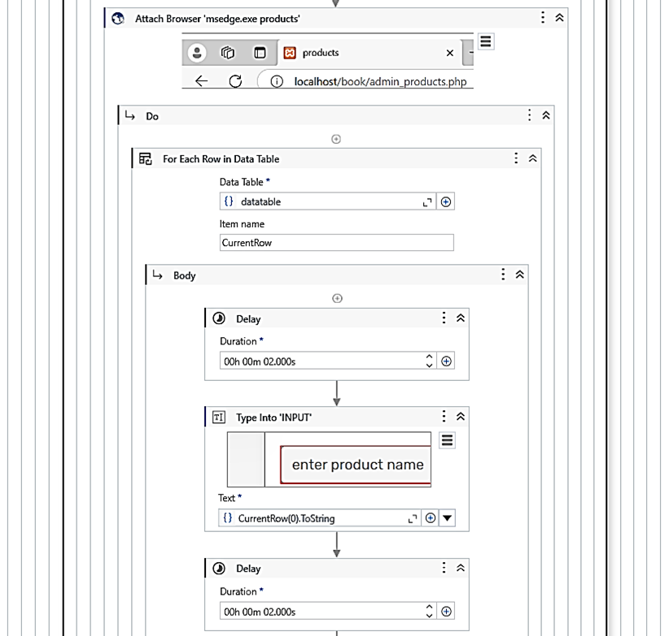
Implementation

Slide 19
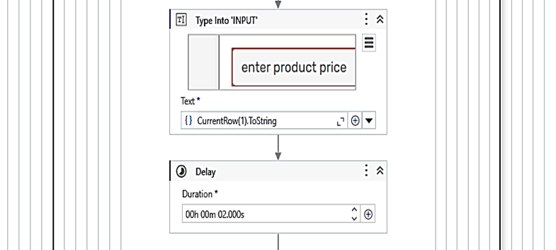
Implementation

Slide 20
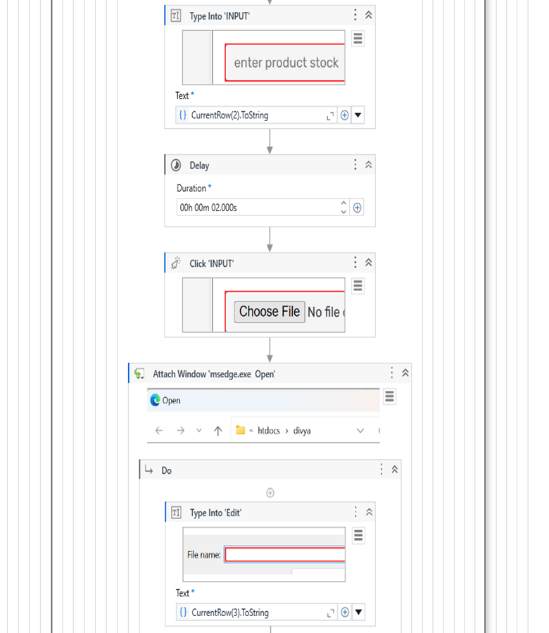
Implementation

Slide 21
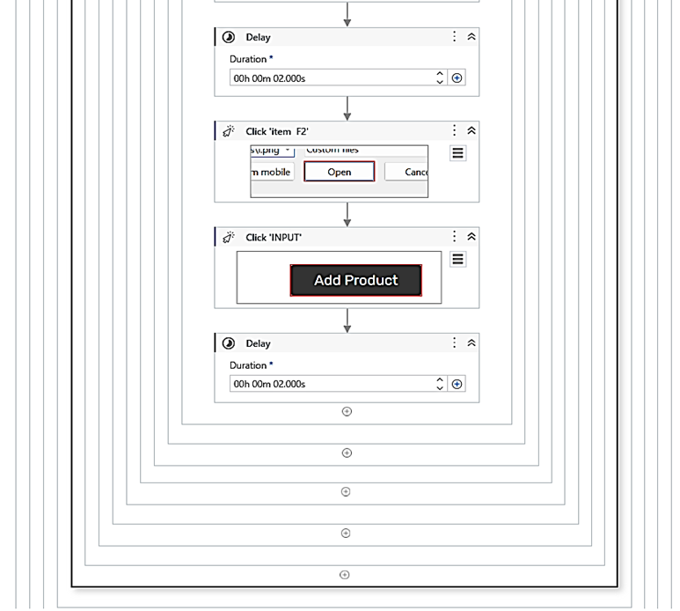
Implementation

Slide 22
Implementation
Module 2: Email Notification for New Arrivals
Short Description: This module automatically sends email notifications to registered users to inform them about newly added books in the eCommerce bookstore. The notification includes details such as the book title, price, and a link to view or purchase the book. This ensures enhanced user engagement and keeps customers updated about the latest products.

Slide 23
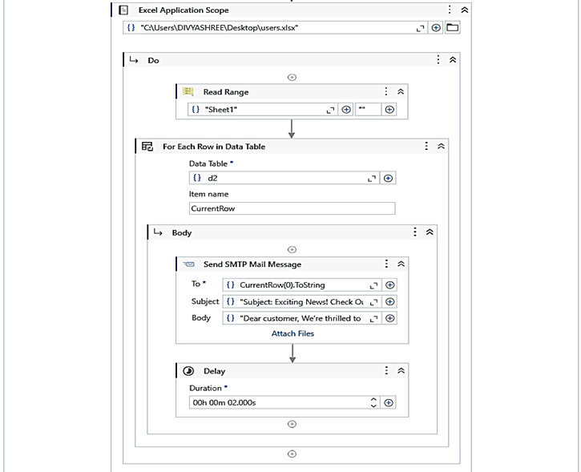
Implementation

Slide 24
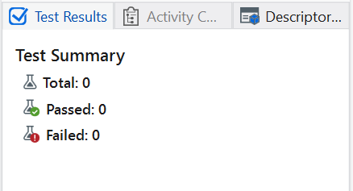
Testing

Slide 25
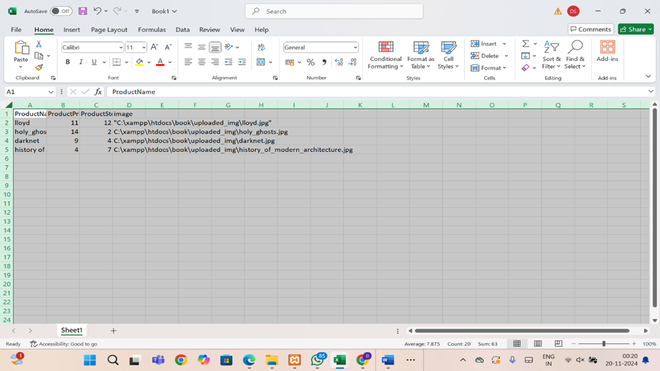
Testing

Slide 26
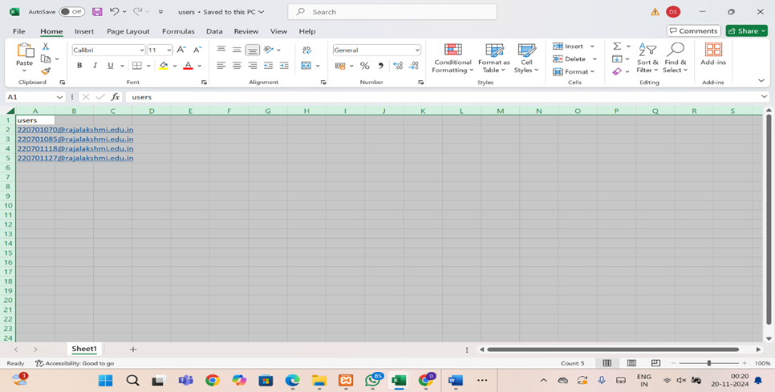
Testing

Slide 27
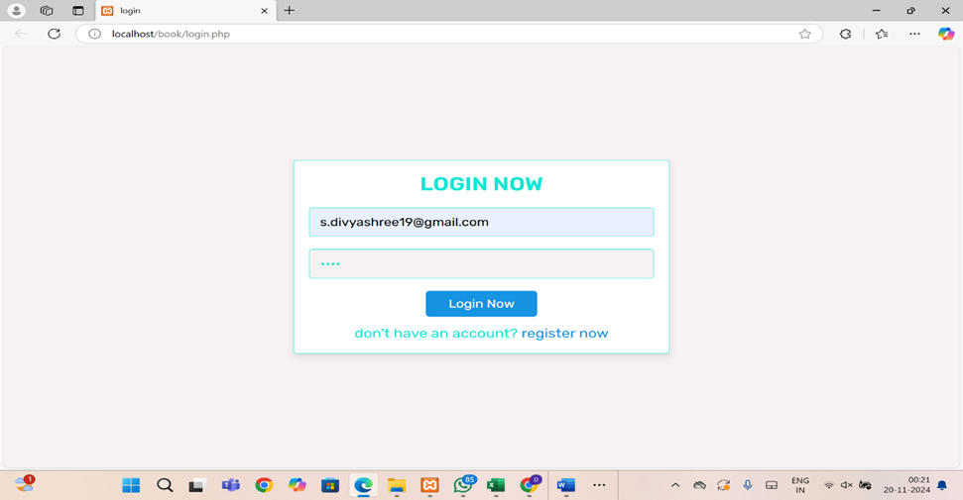
Testing

Slide 28
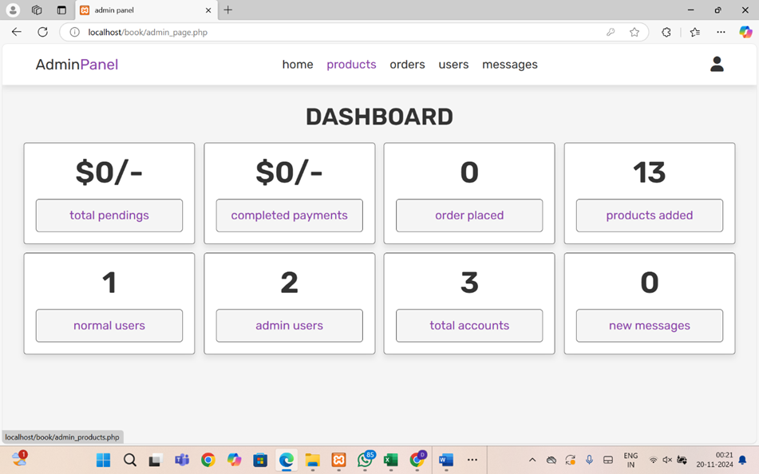
Testing

Slide 29
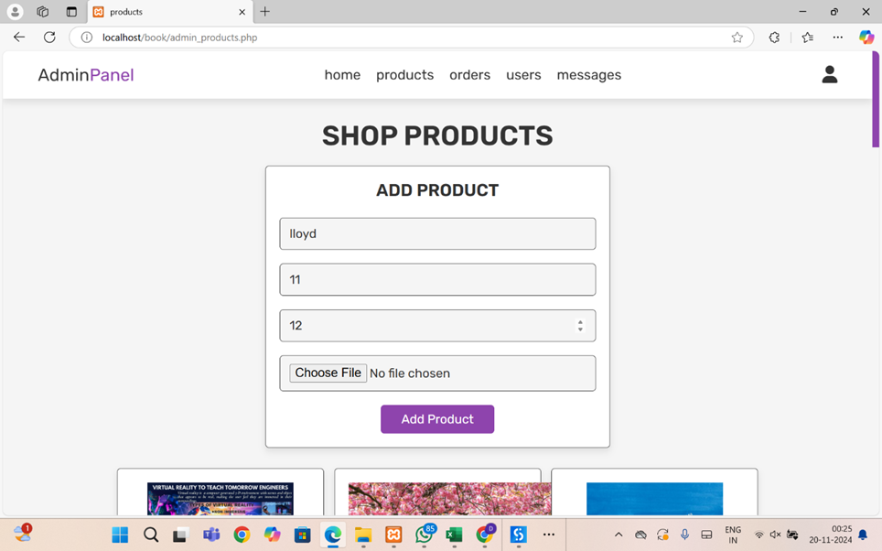
Testing

Slide 30
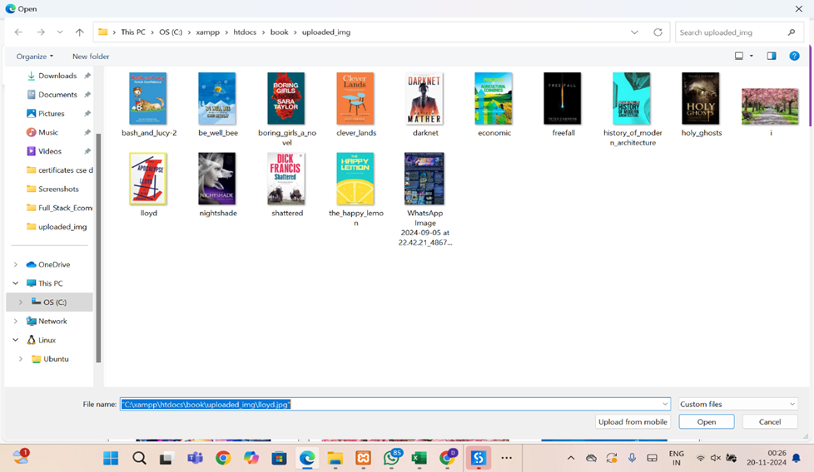
Testing

Slide 31
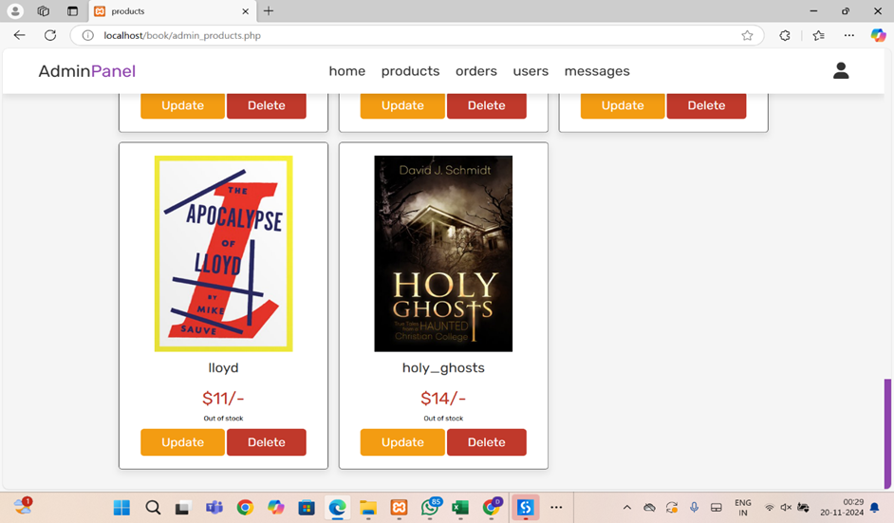
Testing

Slide 32
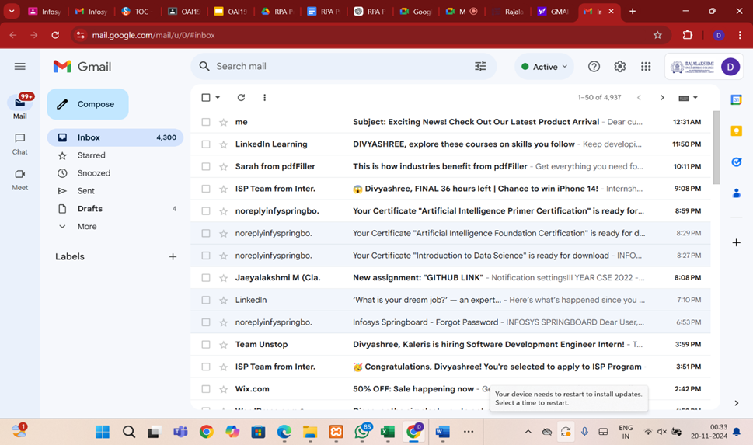
Testing

Slide 33
Conclusions
The project, Automated Product Data Entry for an eCommerce Bookstore, leverages RPA to streamline data entry, reducing manual effort, time, and errors. The bot efficiently extracts product details from Excel and inputs them into the Admin Panel, ensuring accuracy and consistency. Automated email notifications enhance user engagement by informing customers about new arrivals. This scalable solution improves operational efficiency and user experience, laying a strong foundation for future enhancements like advanced data validation, product categorization, and expanded automation features.

Slide 34
Future Enhancement
Advanced User Notifications: Personalized notifications can be sent to users based on their browsing history, preferences, and past purchases. This ensures users receive updates about new arrivals or offers relevant to their interests, improving engagement and conversion rates.
Automated Price Updates: The system can automatically adjust product prices based on market trends, competitor pricing, or stock availability. This ensures prices remain competitive and reflect current demand, optimizing sales and profitability without manual adjustments.

Slide 35
IEEE Paper
Title: Robotic Process Automation with AI and OCR to Improve Business Process: Review
Authors: Sumit Bansal, Vikram Kaushik
Description: Reviews the integration of RPA with AI and OCR to streamline repetitive tasks and enhance accuracy in business processes
Title: Implementation of Robotic Process Automation (RPA) in Digital Marketing
Authors: Rakesh Ranjan, Aditi Sharma
Description: Explores the use of RPA for automating data-heavy marketing tasks, offering insights applicable to eCommerce operations.

Slide 36
References
1. UiPath Forum: The UiPath Forum community where users share their experiences and solutions. https://forum.uipath.com/
2. UiPath Documentation: The official documentation of UiPath features and functionalities https://docs.uipath.com/

Slide 37
Queries:
Dynamic Web Elements
Challenge: Some web elements had dynamic IDs or attributes, making consistent identification difficult.
Solution: Stable selectors, such as relative XPath and anchor-based strategies, were used to reliably identify the elements.
Slow or Unresponsive Web Pages
Challenge: Web pages occasionally loaded slowly, causing bot actions to time out.
Solution: Added delays and a "Retry Scope" mechanism to handle varying loading times effectively.

Slide 38
Demonstration
Show Input Data:
Open the Excel file containing product details (e.g., Book Title, Price, Stock, Description).
Bot in Action:
Launch the bot to demonstrate:
Reading data from the Excel sheet.
Logging into the Admin Panel of the eCommerce site.
Automatically filling in and submitting product details.
Email Notification:
Highlight how the bot sends automated emails to users about new product arrivals.

Slide 39
Thank You

